Slide 1
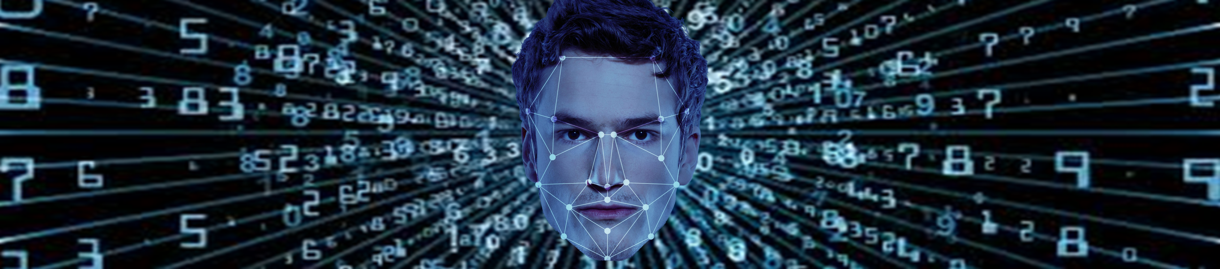
De-duplication of Entities with-in a cluster using Image matching

Slide 2
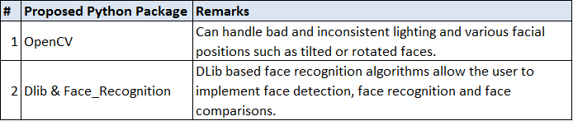
Methodology
Facial feature vectorization with dlib and face_recognition libraries of python for detection of duplicate faces:
The Machine Learning algorithm goes through the data and identifies patterns in the data. To identify whose face is similar in a set of given photographs, there are multiple things we can look at as a pattern. Example : Height/width of the face, Average colour of face (R, G, B), Width of other parts of the face like eye, nose, the ratio of height of the face to the width of the face and others features
Different faces have different dimensions while similar faces will have similar dimensions.

Slide 3
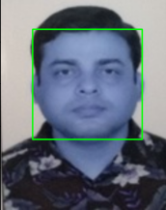
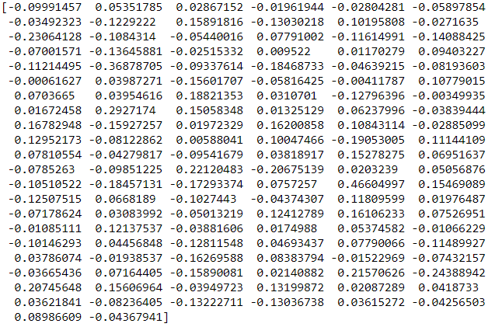
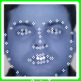
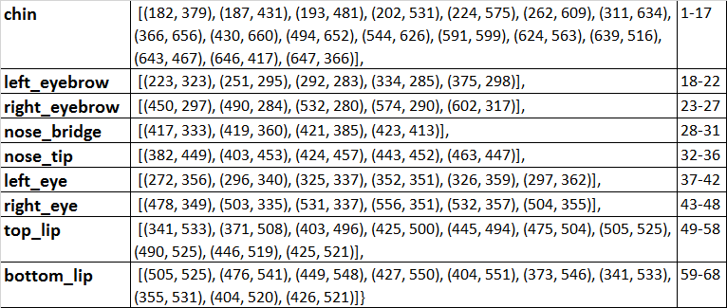
Face Detection and Feature Vectors
This methodology involves converting a particular face into numbers. For every image the algorithm first detects the face and then perform the facial landmarks.
Face Detection
Facial Encoding (128-dimensional points)
Facial Landmarks
2-dimensional Landmarks (68 (x, y)-coordinates))
1
Faces in this system are then encoded and represented as 128-dimension points as face vectors. Each of these numbers represents an orthogonal component of the face encoding.

Slide 4

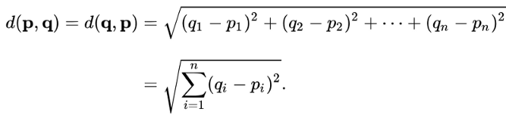
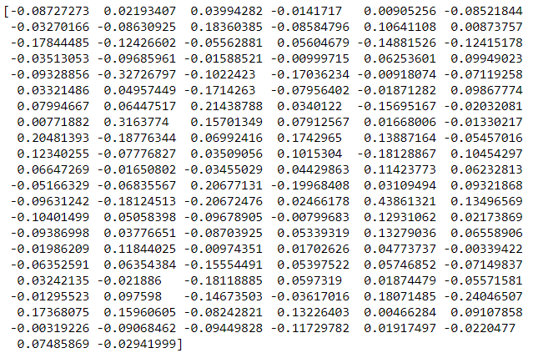

Face Comparison with Euclidean Distance
The 128 measurements of each face is also known as embedding. We need to run our face images through the pre-trained network provided by OpenFace* to get the 128 measurements for each face. Researchers have discovered that the most accurate approach is to let the computer figure out the measurements to collect itself. Deep learning does a better job than humans at figuring out which parts of a face are important to measure.
Facial Encoding
Euclidean distance
Image1
Image2
*OpenFace has published serveral trained networks. Here, OpenFace uses Google’s FaceNet architecture for feature extraction.
Notes:
OpenFace provides pre-trained deep neural networks.
During the training portion of the OpenFace pipeline, 500,000 images are passed through the neural net. OpenFace trains these images to produce 128 facial embeddings that represent a generic face. OpenFace uses Google’s FaceNet architecture for feature extraction and uses a triplet loss function to test how accurate the neural net classifies a face.

Slide 5

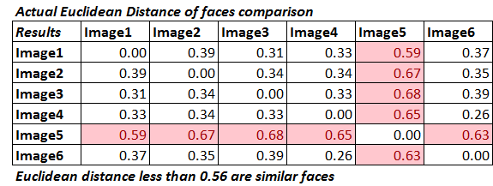
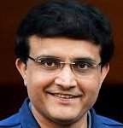
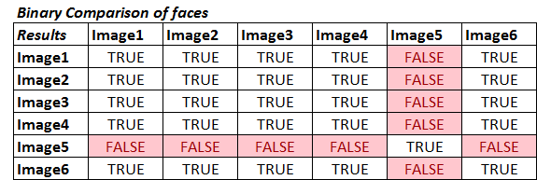


Methodology – Face Comparison in a set of Images
Machine Learning algorithm can intelligently label out many of facial features and once the feature vectors have been obtained the algorithm needs to compare the feature vectors of different images.
Image1
Image4
Image2
Image5
Here, faces are considered a match if the Euclidean distance between the face vectors is 0.56 or less.
With decrease in Euclidean distance, chances of a match increases and vice versa.
Image3
Image6

Slide 6
Relevant Links and References
https://www.analyticsvidhya.com/blog/2018/08/a-simple-introduction-to-facial-recognition-with-python-codes/
https://face-recognition.readthedocs.io/en/latest/_modules/face_recognition/api.html#face_distance
https://github.com/ageitgey/face_recognition/wiki/Face-Recognition-Accuracy-Problems

